Slide 1
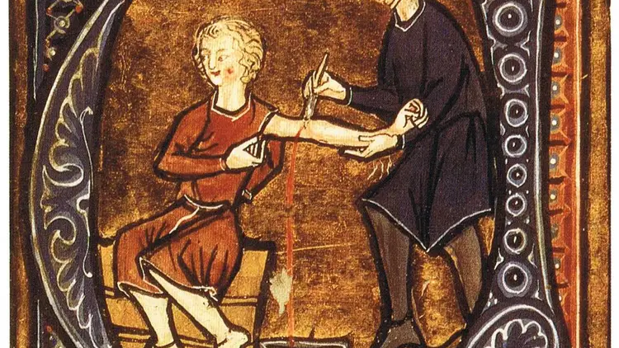
Myths About Disease
GTHBY Human Biology

Slide 2
Review
What Greek words does Microscopium come from?
When did microscopes first have enough magnification and clarity to observe bacteria, white blood cells or nuclei of cells?
When were electron microscopes first used to view viruses?
Who first used the term “cell” to describe cells?

Slide 3
Learning Intentions
Use of microscopes to dispel myths and misconceptions of disease

Slide 4
Success Criteria
Describe beliefs about infectious diseases throughout history
Explain how our understanding of infectious disease has evolved with developments in technology, including microscopes.

Slide 5
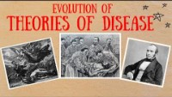

Slide 6
Guided Notes: Myths about Disease

Slide 7
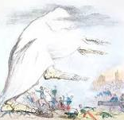
Miasma Theory
Miasma refers to poisonous vapour, or bad air, which is given off by decomposing organic matter.
The miasma theory was popularised in the fourth century BCE by Hippocrates, but had its origins in ancient China and earlier European cultures.

Slide 8
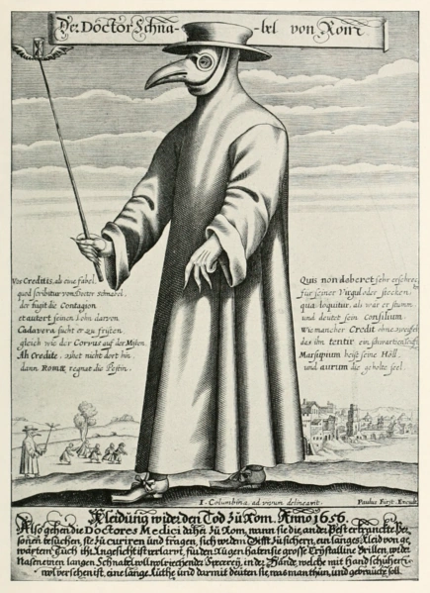
Miasma Theory
This theory suggested that environmental factors, such as contaminated water or poor hygiene were responsible for disease. This led to many interventions and practices with genuine benefits, which made this theory long lasting.

Slide 9
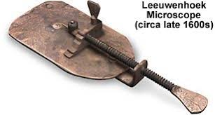
Impact of microscopes
When Hippocrates was first promoting miasma theory, even reading stones were not widely available.
The first microscope that allowed scientists to observe bacteria was not developed until the late 1600s, by Antonie van Leeuwenhoek.
Miscroscopes to detect viruses were not developed until the 1900s.

Slide 10
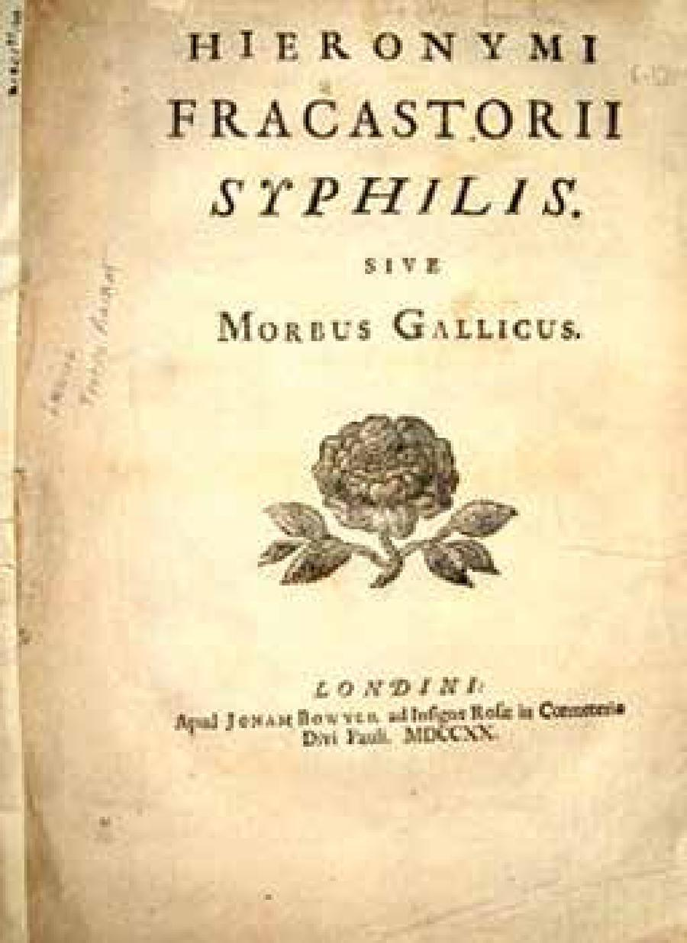
The seeds of disease
In 1546, Italian physician Girolamo Fracastoro described imperceptible seed-like particles, which could multiply rapidly and were unique to each disease.

Slide 11
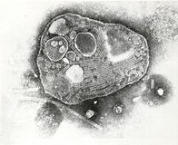
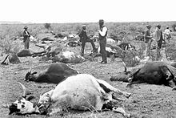
Contagium Vivum
In the 1760s, Carlo fransesco Cogrossi proposed the theory of contagium vivum, or living contagion, the idea that diseases were caused by living organisms. This would later be called Germ Theory, although it did not catch on because of the popularity of the miasma theory.

Slide 12
Success Criteria
Describe beliefs about infectious diseases throughout history
Explain how our understanding of infectious disease has evolved with developments in technology, including microscopes.

